Slide 1

Predicting Customer Buying Behavior
07/10/2023

Slide 2
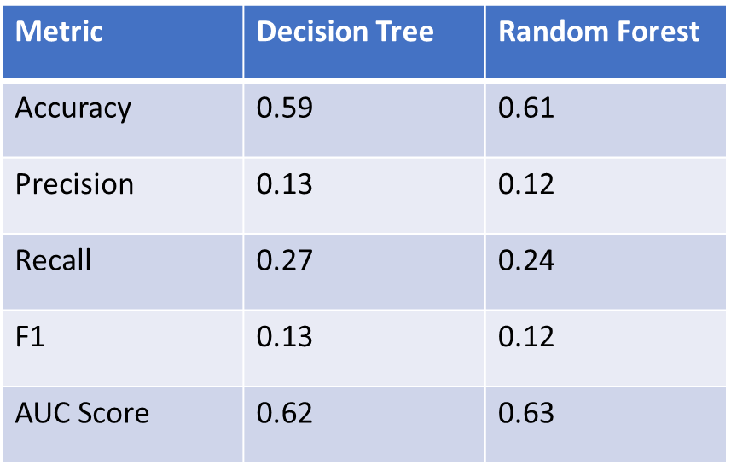
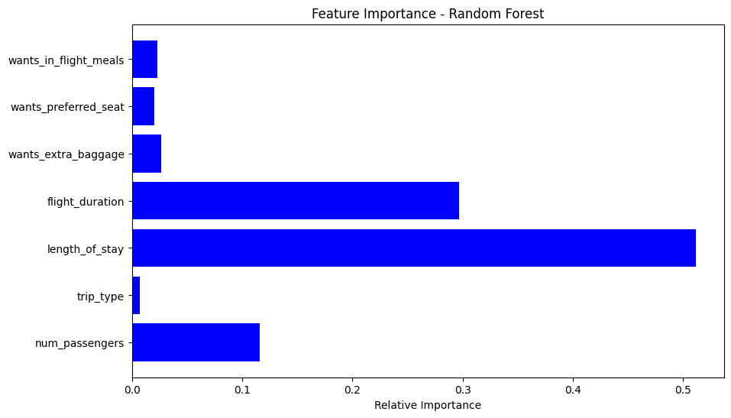
Insight from Customer Booking Data
Evaluation
AUC score for Decision Tree and Random Forest are 0.62 and 0.63 respectively, showing that this model requires more improvement. I suggest adding more customer-centric features into the model.
The most important variable in the model was length_of_stay, that is the time between purchase and departure.
Information about the flight, e.g., flight time and duration was also significant, however booking origin of the customer was not important.

